Slide 1


Oral Communication Skills A
(CELEN069)
Core Unit 6
Artificial Intelligence
Lesson 10.1

Slide 2
Reminder
For homework, you should have watched Lecture 5B: Technology and sedentary lifestyles and taken notes.
Later in the semester, you will use these notes to revise for the Group Discussion Exam.

Slide 3
Lesson aims and objectives
By the end of this lesson, you should have enhanced your speaking and listening ability through practice.
In addition, you should be better able to … | Intended Learning Outcomes
recognise a lecturer’s stance | 1.1-1.3 1.4 1.5 2.7 3.3 3.6
produce an effective summary of a lecture
adopt your own stance on a lecture topic in a discussion

Slide 4

Getting started

Slide 5
Getting started
“… public perceptions of AI are changing. And that’s not really surprising since society has quickly moved from a time when AI was conceptual, the realm of science fiction movies and mad scientists with white coats, to now, when it’s a reality.”
The above extract is a quote from today’s lecture on the topic of AI.
In your group, discuss some of the questions below.
In what areas of your life is AI a reality? Is this positive or negative?
In what other areas of human society is AI a reality?
How do you think perceptions of AI may have changed over the last 30-40 years?

Slide 6

Preparing for the lecture

Slide 7


Preparing for the lecture: Vocabulary building (A)
A. Check your answers to the homework task.
1 | concept (n) | A concept is the __________ __________ behind something.
2 | imagination (n) | Your imagination is the part of your __________ mind that allows for the __________ of possibilities and ideas.
3 | replicate (v) | To replicate something is to __________ something or make a __________ of it.
4 | continuum (n) | If something is on a continuum, it is part of a __________ or __________ process rather than a separate element.
5 | categorise (v) | To categorise items is to __________ them into specific __________.
6 | algorithm (n) | An algorithm is a __________ for solving a __________ problem involving multiple stages.
7 | archaic (adj) | If something is archaic then it is __________ or less effective than a __________ alternative.
8 | neuroscience (n) | Neuroscience is the field of __________ relating to the __________.
9 | perception (n) | A perception is the __________ that someone has of something or the way they __________ it.
10 | zeitgeist (n) | A zeitgeist is the intellectual and moral __________ of a particular time __________.
A concept is the underlying idea behind something.
Your imagination is the part of your conscious mind that allows for the creation of possibilities and ideas.
To replicate something is to reproduce something or make a copy of it.
If something is on a continuum, it is part of a gradual or ongoing process rather than a separate element.
To categorise items is to divide them into specific groups.
An algorithm is a calculation for solving a mathematical problem involving multiple stages.
If something is archaic then it is outdated or less effective than a modern alternative.
Neuroscience is the field of study relating to the brain.
A perception is the view that someone has of something or the way they understand it.
A zeitgeist is the intellectual and moral feeling of a particular time period.

Slide 8
Preparing for the lecture: Vocabulary building (B-C)
B. Check your answers to the homework task.
C. Then, read the sentences out loud and see if your partner agrees or disagrees with each statement.
 |  | Partner response (agree / disagree)
1 | A robot (its / cannot / imagination / use) to provide creative solutions to problems.
 | A robot cannot use its imagination to provide creative solutions to problems.
2 | (that / perception / is / general / a / There) driverless cars are dangerous and unnecessary.
 | There is a general perception that driverless cars are dangerous and unnecessary.
3 | Robots will never (care / to / be / replicate / the / able) given by humans in hospitals.
 | Robots will never be able to replicate the care given by human beings in hospitals.
4 | When it comes to AI, (current / one / is / the / zeitgeist) of great optimism for the future.
 | When it comes to AI, the current zeitgeist is one of great optimism for the future.
5 | A ‘smart home’ (for / concept / can / difficult / a / be) older people to understand.
 | A ‘smart home’ can be a difficult concept for older people to understand.
6 | AI may soon be able to read our minds and (thoughts / us / to / our / categorise / according).
 | AI may soon be able to read our minds and categorise us according to our thoughts.

Slide 9
Preparing for the lecture: Listening and note-taking focus
Lecturer’s Stance
In order to really understand a topic, it is important to remember that a speaker will have their own viewpoint and attitudes towards the ideas they are presenting. This is called a stance.
Recognizing stance
A stance could be obvious, or less obvious. There are certain indicators:
Language choices
Word choice can be a clear indicator of stance. Listen out for:
Use of adjectives and nouns
e.g. exciting/ worrying - success/ failure
Pronouns
The use of we/ our indicates importance through relevance to us.
e.g. we have a responsibility, our future
Intensifiers and qualifiers
These indicate degree of certainty.
e.g. It is clearly evident/ It is highly unlikely
Signposting language
e.g. On the one hand … on the other hand …
Paralanguage
Facial expressions, body movement and tone of voice may indicate the emotion or attitude towards an idea.
Enthusiastic, serious, annoyed
- may indicate a strong stance
Humorous, indifferent
- may indicate less importance
Hesitant, careful
- may indicate complexity of stance or idea

Slide 10
Preparing for the lecture: Listening and note-taking focus
Listen to four brief extracts from today’s lecture on AI.
What do you think the lecturer’s stance is in each instance? Use the guiding questions below to help you.
 |  | Extract
What is the lecturer’s stance on … | … robopsychology? | 1
 | … whether a conscious AI is desirable? | 2
 | … whether robot responses to emotions are human? | 3
 | … progress in AI research? | 4

Slide 11
Preparing for the lecture: Listening and note-taking focus
What is the lecturer’s stance on robopsychology?
Extract 1
‘There is now a field called ‘robopsychology’, which is the study of personality and behaviour in intelligent machines. It’s interesting, right?’
The lecturer is most likely interested in the topic:
He uses the adjective ‘interesting’.
He uses a question tag (i.e. ‘right?’) to seek agreement with his view.

Slide 12
Preparing for the lecture: Listening and note-taking focus
What is the lecturer’s stance on whether a conscious AI is desirable?
Extract 2
‘And you might ask whether this is desirable? Would a conscious AI be positive for humans? Well, we certainly need to be cautious.’
The lecturer indicates a strong but neutral stance:
He uses ‘we’ to reflect the importance of the topic to everyone.
He uses the intensifier ‘certainly’.
He uses the adjective ‘cautious’.

Slide 13
Preparing for the lecture: Listening and note-taking focus
What is the lecturer’s stance on whether robot responses to emotions are human?
Extract 3
‘Well, it’s difficult to say. We partly learn to respond to emotions in a very similar way as AI. But at the same time, we could argue it is not human because it lacks real feeling or consciousness. Would you agree?’
The lecturer suggests that the topic is debatable/ complex:
He uses the adjective ‘difficult’.
He uses signposting (i.e. ‘But at the same time’) to refer to two opposing sides of the argument.

Slide 14
Preparing for the lecture: Listening and note-taking focus
What is the lecturer’s stance on progress in AI research?
Extract 4
This shift is due to significant progress in AI research, which has changed the way all of us live. Some of these impressive developments are discussed by …
The lecturer is most likely positive, and feels the topic is important:
He uses the adjectives ‘significant’ and ‘impressive’.
He uses ‘all of us’ to reflect the importance of the topic to everyone.

Slide 15

Listening to the lecture

Slide 16
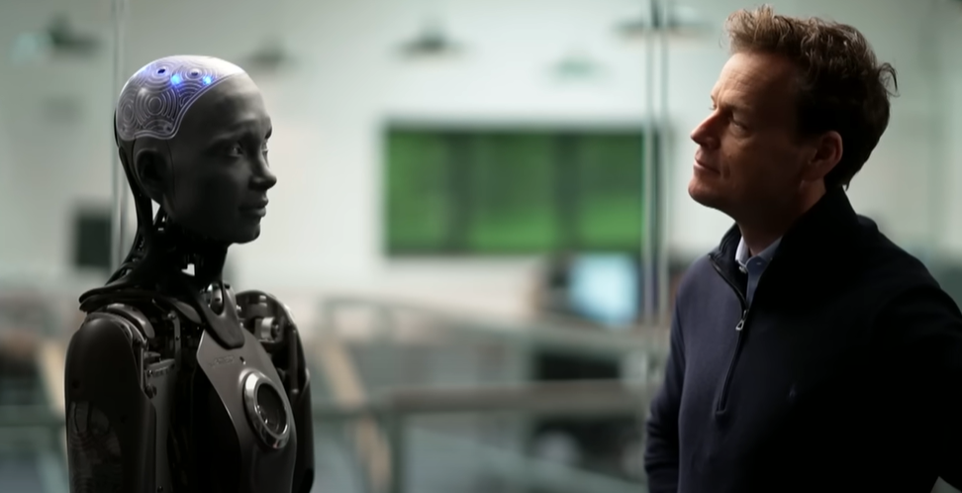
Listening to the lecture: Lecture content focus
For homework you watched an interview with Ameca, an AI robot and completed the ‘Getting started’ section from Lesson 10.1 in the Class Workbook.
Today you are going to watch Lecture 6A ‘The current state of artificial intelligence’.
Before you watch, use your notes from the homework to discuss your ideas on the current state of artificial intelligence.

Slide 17
Listening to the lecture: Listening
Watch Lecture 6A ‘The current state of artificial intelligence’ and take notes as you listen.

Slide 18
Listening to the lecture: Comprehension check - Main ideas
Use your notes to answer the questions below.
What is the difference between strong and weak AI?
Weak AI = unconscious systems with a particular function
Strong AI = robots with human characteristics
How is the distinction between strong and weak AI changing?
The difference between strong and weak AI is not so clear anymore; it is more like a continuum.
How does AI currently learn?
AI currently learns through ‘deep learning’, which means it is given large amounts of pre-structured data.
What is the problem with the way AI currently learns?
‘Deep learning’ is archaic; it is limiting the development of AI.
How can progress be made in the way AI learns?
With significant input from modern neuroscience about how the brain learns.
How have public perceptions of AI changed?
In the past, they were based on science fiction, now they are based on reality.

Slide 19
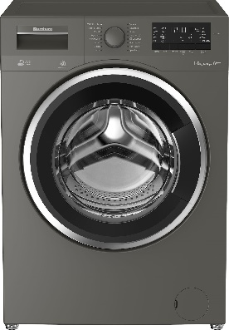




Listening to the lecture: Comprehension check - Details
Use your notes to discuss how the examples below link to the main ideas mentioned in the lecture.
a. washing machine
b. AI’s ability to recognize human emotions
c. robopsychology
d. medicine
e. job losses

Slide 20
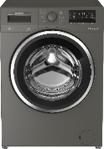




Listening to the lecture: Comprehension check - Details
Answers:
a. washing machine
This is an example of ‘weak AI’.
b. AI’s ability to recognize human emotions
This is an example of the current state and limitations of AI.
c. robopsychology
This is an example of how neuroscience is being used to help develop AI.
d. medicine
This is an example of how current use of AI is creating positive perceptions.
e. job losses
This is an example of how current use of AI is leading to concerns/ negative perceptions.

Slide 21
Listening to the lecture: Summary
As part of the Independent Learning Week materials, you looked at lecture summaries.
Work with a partner. Give each other a brief oral summary of the lecture. Include the lecturer’s stance.
Summarising
When writing a summary, you should focus on the 3Cs:
Completeness: Are all main ideas included?
Clarity: If you were to read the summary a month from now, would you understand it?
Concision: Have you focused on including only the necessary information?

Slide 22

Developing the topic

Slide 23
Developing the topic
Part 1
Choose a number 1-10. The number should represent how you feel about the future of AI. (1 = very negative, 10 = very positive)
Write the number on a small piece of paper. Keep it in your hand. Your number is a secret.
As a class form one line. The line should run from very negative to very positive. You should talk to each other to determine your position, but you cannot tell anyone your number.
Once you have formed a line, reveal your numbers. The class challenge is to have numbers running perfectly in sequence.

Slide 24
Developing the topic
Part 2
Form a group with 3-4 other people near you in the line.
With reference to some of the ideas from the lecture, discuss how you think AI will develop over the next 50 years. Be prepared to share your ideas with the class.
Possible ideas from the lecture to discuss:
Emotions
Consciousness
Developments in AI learning (a mathematical theory of intelligence, robopsychology)
Perceptions of AI

Slide 25
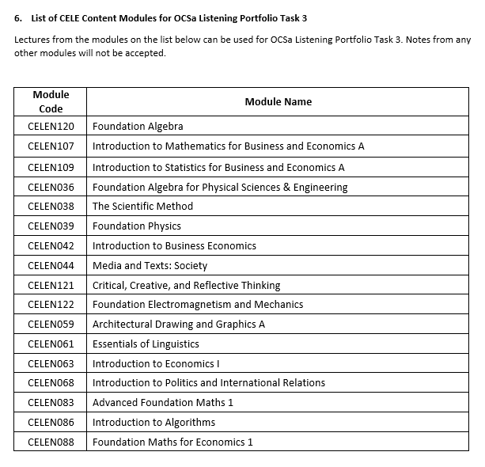
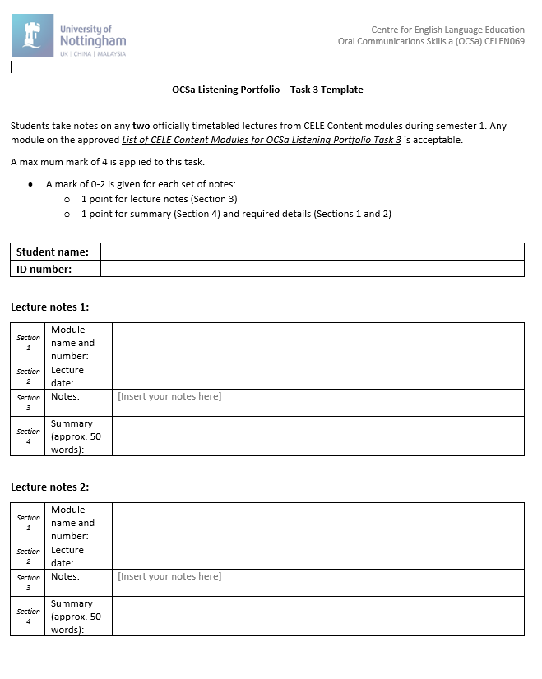
Reminder: Listening Portfolio Task 3
You must take notes on any two officially timetabled lectures from CELE Content modules during Semester 1. Any module on the approved List of CELE Content Modules for OCSa Listening Portfolio Task 3 is acceptable (see Module Handbook - Appendix 1).
You must use the OCSa Listening Portfolio Task 3 Template provided.
You must complete all sections on the template.
The notes for this task must be submitted to Moodle by` Week 12, Monday 16th December, 3pm.

Slide 26
Homework
Due | Task
Lesson 10.2 | Watch Lecture 6B: Issues with AI and take notes. ​ You will use these notes later when you revise for the Group Discussion Exam.
 | Review the OCSa Group Discussion Exam Information (Module Handbook – Appendix 2). Download a copy of the OCSa 24-25 Group Discussion Descriptors (available on the CELE Assessment Moodle page) and bring it to class.

Slide 27

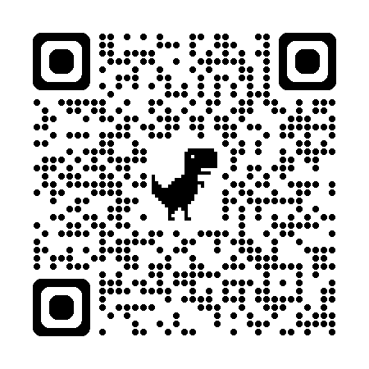
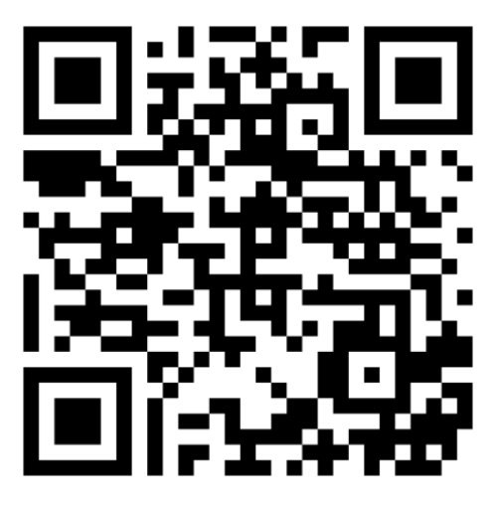
Week 10
Extra resources for OCSa this week on the Writing Lab Moodle page:
Speaking → University speaking tasks (group discussions)
Next week (Week 11 – beginning the 9th of December):
Utalk continues!
Monday, Tuesday, Thursday, Friday = PB 115 1:00 – 1:50pm
Wednesday = PB 201 1:00 – 1:40pm
Evening sessions available (check SPDPO system for times)
NEW!
Extra group discussion practice (with feedback)
Sign up via the Writing Lab Friday email.
Centre for English Language Education CELE N048 AY 24-25

